Slide 1


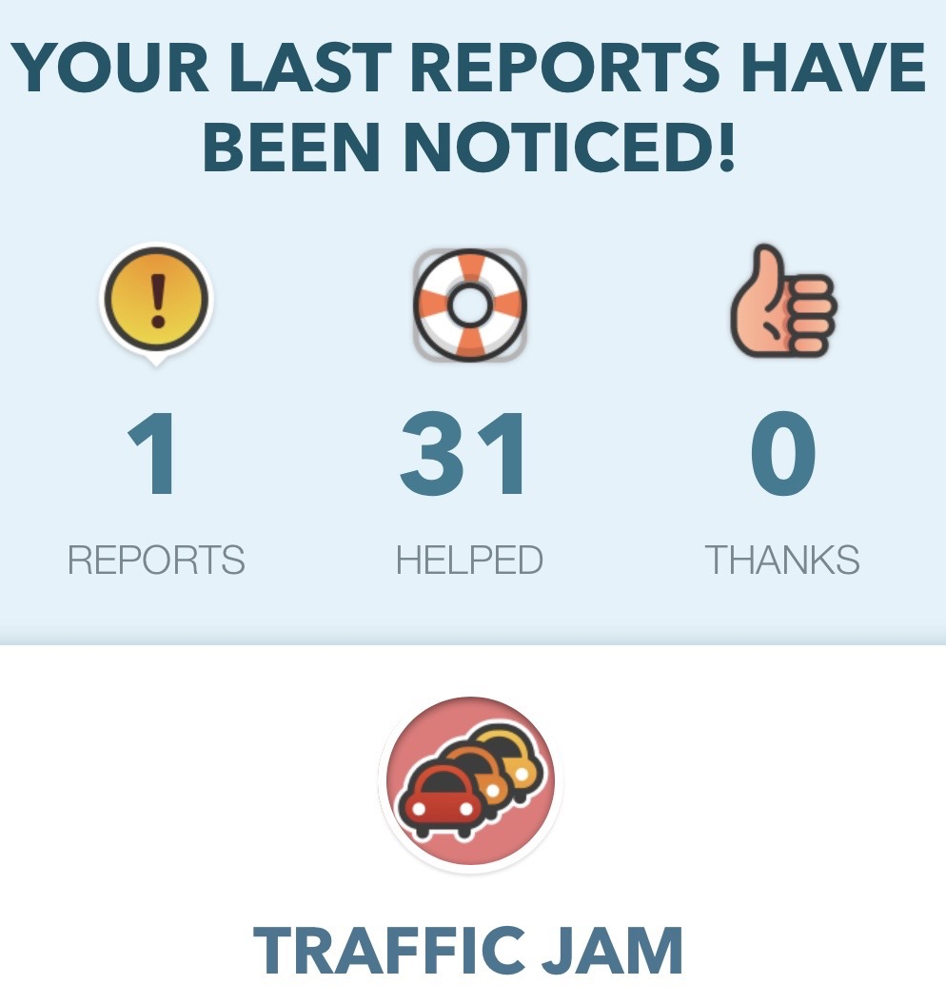
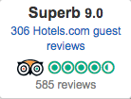
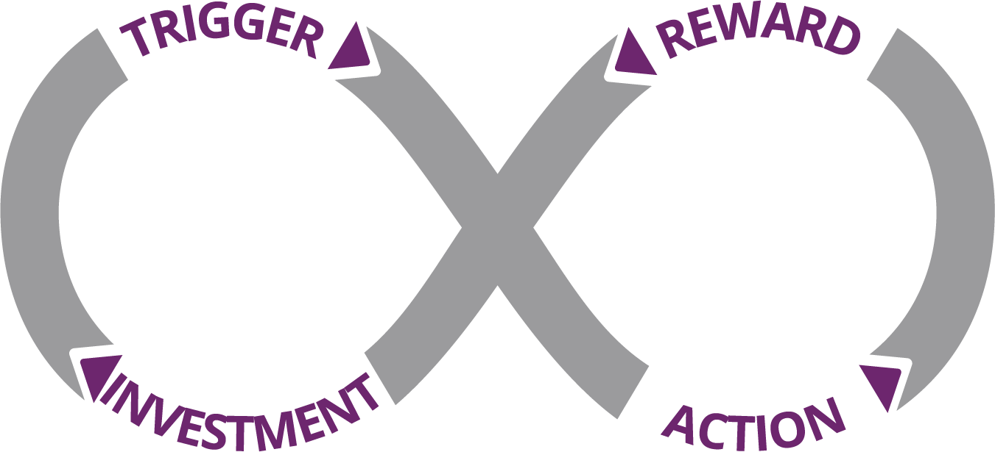
Engagement - Make Exponential Growth Stick!
Engagement captures, holds and deepens the interest and involvement of the customer, crowd, community, partners and your internal team through the use of gamification, digital rating systems, loyalty programs and/or incentive competitions.
It is driven from your Massive Transformative Purpose (MTP) or other powerful reason to be part of a community. Done well, it creates and reinforces connections between stakeholders and drives desired behaviors to help your Exponential Organization (ExO) scale.
Gamification is the application of gaming mechanics and experience design to non-gaming contexts to encourage engagement and motivate desired behavior. While powerful if done right, just adding badges, points and a leaderboard to your offering isn’t enough. Good design and Experimentation is essential.
Waze gamifies traffic reporting, providing feedback to the user about the impact of their report, and awarding increased social ranking through repeated use.
MMOS (Massive Multiplayer Online Science) engages non-scientists in research tasks programmed within online games, with in-game rewards to keep participants engaged. See Citizen Science at Zooniverse.org
Game Effective is workforce tool that gamifies learning, performance and motivation.
Digital Reputation Systems as used by Yelp, Uber, Angie’s List, Hotels.com and others invite users to rate their experience with a restaurant, hotel or vendor. Airbnb enlists the feedback from both hosts and users to rate and recommend the guest as well as the accommodation.
Incentive Competitions provide a reward for solving a challenge. These competitions can increase the profile of the issue and attract a diverse group of people to find innovative solutions much faster than imagined.
XPrize ignites the innovation of the crowd to solve global challenges. The Global Learning XPrize is a $15 million competition to empower children to take control of their own learning. Learn to design YOUR incentive competition at Hero^{X}.com.
The Department of Homeland Security posted a $1.5 m passenger screening algorithm challenge on Kaggle.com in 2017 to expedite processing at US airports while improving accuracy of threat recognition algorithms.
Rewards and Loyalty Programs, such as frequent flyer miles, reward repeated use of your product or service. Digital currency is being used to reward participation or certain desired behaviors (i.e diet and exercise behavior in an insurer’s wellness program.)
Engagement is important for ExOs because it:
Increases loyalty of individuals and community
Expands ideation and ignites innovation
Helps convert your crowd to your community
Creates opportunities for play and learning
Can create a virtuous cycle of reinforced attraction
Tip: Make sure you know your customer segment and their jobs-to-be-done. Do experiments to refine the desired healthy behaviors. Hooked, by Nir Eyal, is an excellent resource.
*See Chapter 3 - The Exponential Organization in Exponential Organizations by Salim Ismail, Michael S. Malone & Yuri van Geest. The Exponential Organizations Master Business Course is a part of the Growth Institute MBD Program.
To learn more, visit www.growthinstitute.com/exo Share this tool - info.growthinstitute.com/engagement-tool
Work licensed under Creative Commons Attribution-NoDerivatives 4.0 International License. By Growth Institute Inc. For a copy of this license, http://creativecommons.org/licenses/by-nd/4.0/ Rev 1.0 2018-07-10 TO LEARN HOW TO USE THIS TOOL, VISIT www.growthinstitute.com/exo

Slide 2



Engagement - Designing for Engagement
Experiment 1: Help form a Habit - This exercise is from Hooked: How to Build Habit-Forming Products by Nir Eyal with Ryan Hoover. nirandfar.com
The Basics of Habits
Habits are defined as “behaviors done with little or no conscious thought”.
Hooks are experiences designed to connect the user’s problem to a solution frequently enough to form a habit.
The Hook Model has four phases: trigger, action, variable reward, and investment.
Frequency Matters - To form a habit, people must do the behavior frequently (i.e. at least weekly.)
The Hook Canvas
3 types of Variable Rewards
Rewards of the Tribe: the search for social rewards fueled by connectedness with other people.
Rewards of the Hunt: the search for material resources and information.
Rewards of the Self: the search for intrinsic rewards of mastery, competence and completion.
What product or service do you want to make more engaging?
Why does your business model require users form a habit? e.g. “We sell a razor that uses disposable razor blades, so we need people to shave frequently and reorder.” “To scale, we will contain customer service staffing and other costs through peer-to-peer support.”
What problems are users solving with your product?
How do users currently solve that problem and why does it need a solution?
What is the user behavior you want to turn into a habit? (the intended habitual behavior) “User visits forum to support peers.”
How frequently do you expect users to engage with your product? (Note: If the behavior does not recur within a week’s time or less, you may have a difficult time forming a habit. Go to step 5 and select something else.)
Ethical Check: Does this habit materially improve the user’s life? If the answer is No, re-evaluate. You may be designing an Addiction rather than a habit. See also Core Values in the Autonomy Tool.
Next (exponential) Steps: Complete Exercises 2+ in Hooked, (special offer) then iterate with the ExO Experimentation Tool to improve your results!
What internal trigger is the product addressing?
What external trigger gets the user to the product?
4. Is the reward fulfilling, yet leaves the user wanting more?
5. What “bit of work” is done to increase the likelihood of returning?
3. What is the simplest behavior in anticipation of reward?
Work licensed under Creative Commons Attribution-NoDerivatives 4.0 International License. By Growth Institute Inc. For a copy of this license, http://creativecommons.org/licenses/by-nd/4.0/ ‘Hooked’ content ©2014 Nir Eyal, used with permission. Rev 1.0 2018-07-10 TO LEARN HOW TO USE THIS TOOL, VISIT www.growthinstitute.com/exo
Notes:
$.99 Hooked Supplement https://www.amazon.com/Hooked-Workbook-Supplemental-Habit-Forming-Products-ebook/dp/B01KPBN0PK
info.growthinstitute.com/community-and-crowd-tool

